Slide 1
Statistical Data Analysis And Modeling Using Rapid Miner
Sneha.D.L(12mcs1037) & Sravya(12mcs1012)

Slide 2
Overview
Introduction
What is Data Mining?
What is Rapid Miner?
Benefits of Rapid Miner
Applications of Rapid Miner
Project Goals
References

Slide 3
Introduction
Vast amounts of statistical information are available in today's global and economic environment because of continual improvements in computer technology.To compete successfully globally, managers and decision makers must be able to understand the information and use it effectively. Methods of data analysis are used in a wide variety of occupations and help people identify, study, and solve many complex problems.
Piles of data are collected and important knowledge is often hidden without anybody knowing. Statistical data analysis and modeling are the best methods to retrieve useful information and manage huge data.

Slide 4
What is Data Mining?
DataMining is a process of analyzing data and extracting patterns from it.
Steps in Data Mining are:
Classification – Arrange into pre-defined groups
Clustering - Here groups are not pre-defined(but similar to clasifying)
Regression - find a function that models the data with least errors
Association rule learning - searching for relationships

Slide 5
What is Rapid Miner?
RapidMiner is unquestionably the world-leading open-source system for data mining.
Rapid Miner(formally YALE*-yet another learning environment) written in Java language, is used for research, education, training, rapid prototyping, application development, and industrial applications.
It uses learning schemes and attribute evaluators from the Weka machine learning environment and statistical modeling schemes from R-Project.
Software Versions are:
Community editions (Open-source)
Enterprise Editions

Slide 6
Benefits of Rapid Miner
Multi-layered data view concept ensures efficient data handling and provides powerful high-dimensional plotting facilities
Powerful methods for calculating statistics and analyzing the significance of the results.
Data Integration, Analytical ETL, Data Analysis, and Reporting in one single suite
Powerful but intuitive graphical user interface for the design of analysis processes
Prediction or classification model building, automatic reporting and graphical representation of results
Access to data sources like Excel, Access, Oracle, IBM DB2, Microsoft SQL, Sybase, Ingres, MySQL, Postgres, SPSS, dBase, Text files and
Several plug-ins are already available in market

Slide 7
Applications of Rapid Miner
Text Mining
Multimedia Mining
Feature Engineering
Data Stream Mining
Intelligent data analysis
Data mining, knowledge discovery, machine learning and predictive analytics
Forecasting and analytics in business intelligence (BI).
Distributed Data Mining
Scripting language used in Rapid Miner allows for automating large-scale experiments.

Slide 8
Project Goals
We want to implement the standard data mining tasks :
Importing Data and using Data in Processes
Training a Data Mining Model and Applying Models for Scoring
(ex: Creating a decision tree from a labeled dataset and exporting the model (the classification tree) into a external file (PMML format) for better deployment thereafter)
Visualizing Models and other Results
Evaluation and Performance Estimation (ex: Assessing the model performance using a cross-validation resampling scheme )
Data Transformations
(ex: Apply the model on a set of unlabeled instances, the results, i.e. the values of the descriptors and the assigned class and export them into a CSV file. )
Basically, we want to perform Statistical data analysis and modeling on the defined dataset.

Slide 9
References
http://en.wikipedia.org/wiki/RapidMiner
http://en.wikipedia.org/wiki/Data_mining
http://www.anderson.ucla.edu/faculty/jason.frand/teacher/technologies/palace/datamining.htm
http://www.cs.ubbcluj.ro/~gabis/ml/MLSoftware/rapidminer-4.4-tutorial.pdf
http://rapid-i.com/
Landmarking for Meta-Learning using RapidMiner
Sarah Daniel Abdelmessih1, Faisal Shafait2, Matthias Reif2, and Markus Goldstein2
Next Generation Business Analytics with RapidMiner and RapidAnalytics Open Source Data Mining Software, Solutions, and Services by Rapid-I and its Hungarian Partner United Consult Ralf Klinkenberg Rapid-I GmbH, Dortmund, Germany

Slide 10

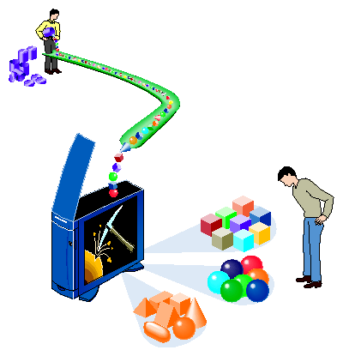
Thank You

